Slide 1
Generating Music Using
Markov Chains
Stochastic Simulation (IT461) Project
Group Members-
Aditya Joglekar - 201401086
Rajdeep Pinge - 201401103
Rushikesh Nalla - 201401106
Omkar Damle - 201401114
Deep Raiya - 201401221

Slide 2
Introduction
From a mathematical viewpoint music is nothing but a sequence of notes. Notes are musical sounds played at a particular pitch.
A chord is a collection of notes played simultaneously.
Song - Sequence of chords. ‘Transition’ of one chord into another.
Set of chords defines the possible states which our song can be in at any instant of time.
It is also important to note what distinguishes ‘music’ from ‘noise’.

Slide 3
Motivation for use of Markov Chain
Music is pleasant because musicians understand which notes sound good together.
Musical theory lays down certain rules which dictate which notes should be used, how can they be combined and in what sequence should they be used in order to play ‘good’ music.
This means that the transitions are not random (that would be noisy) but rather every state has some definite probabilities of transitioning to others governed by musical aesthetics.

Slide 4
Motivation for use of Markov Chain
Markov chains are a very natural way to model such a process. The problem not only has the required structure but Markov chains will allow us capture the musically pleasant transitions.
Remarkably, we will be able to mimic subjective musical aesthetics using a mathematical construct.

Slide 5
Technique
The goal is to obtain a transition matrix.
We parse the input file and examine the chords of the song. At every step we obtain the notes of previous chord and present chord. We assume that every note in previous chord transitions to every note in the present chord.
Accordingly, we keep track of the count of transitions to estimate the probability of state transitions.

Slide 6
Technique
If we use a first order markov chain, we consider only one note from the past as the state.
Similarly for second and third order markov chain, we consider two and three notes from the past respectively as the state.
Finally, we use a combination of the three chains (backoff method). Here we start with random notes. We first look at the third order markov chain. If the required state is not present as a state, then we consider second order markov chain. Similarly, if state is not present in second order transition matrix, we consider first order markov chain.

Slide 7
Implementations
1st order markov chain
2nd order markov chain
3rd order markov chain
Combination of markov chain using best of the 3 markov chains (Explain)
Random Initialization
Song generated even when random initialization
Different song generated each time. Possibility of seterministic behaviour removed.

Slide 8
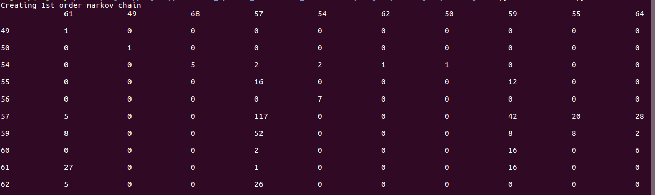
Transition matrix: 1st order Markov Chain(24x24)

Slide 9
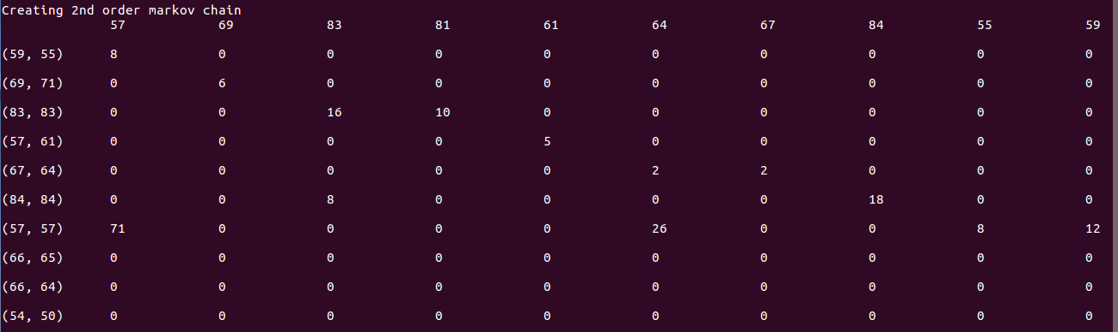
Transition matrix: 2nd order Markov Chain(79x24)

Slide 10
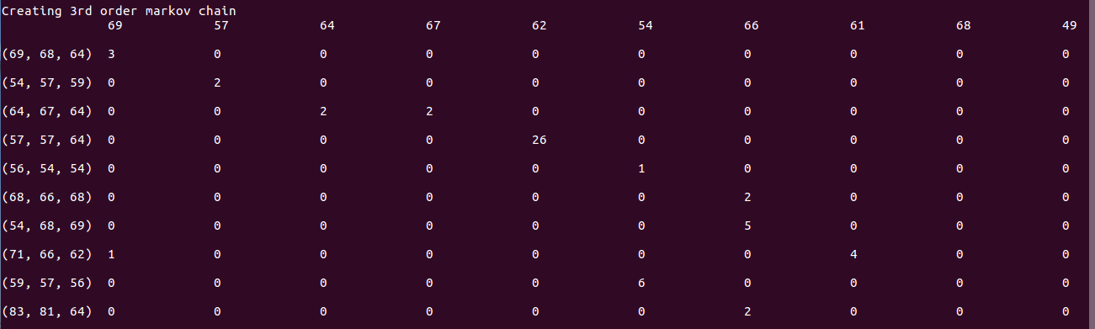
Transition matrix: 3rd order Markov Chain(137x24)

Slide 11
MIDI files
Musical Instrument Digital Interface(MIDI) is a technical standard which allows electronic musical instruments and computers to connect with one another.
They contain information on how to play the tune unlike audio files. This tune can be played by a variety of computer generated instruments.
Consist of header chunks and track chunks.
MIDI files have one header chunk containing information about the “instruments” playing the sounds, followed by track chunks containing the notes played and their durations, velocities (volume), pitch etc.
Libraries used : MidiUtils library, wildmidi (for playing midi file).

Slide 12
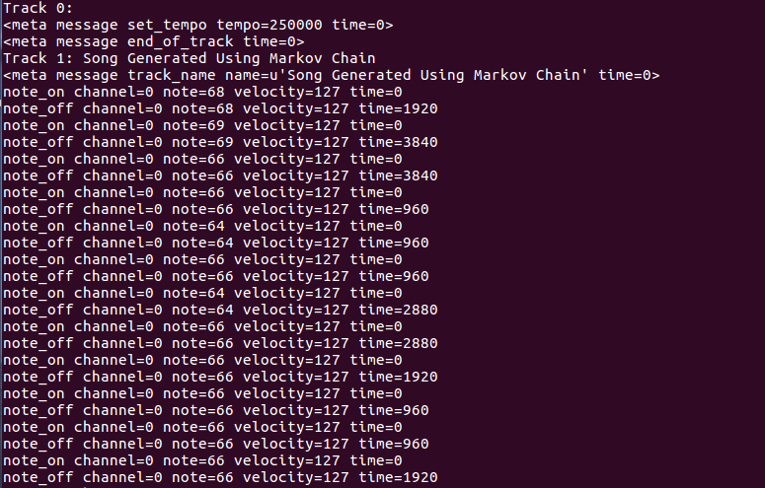
MIDI file example

Slide 13
Observations
The input files contain multi note chords.
The files generated are simple uni-note chords. The music is thus pretty simple compared to the input.
First order music is very simple but has a lot of variations.
In contrast, third order music is complex but is very repetitive because of sparsity of the 3rd order transition matrix.
Backoff technique is used to remove deterministic behaviour in the system. With this method, any random starting point can be used and the music will still be generated.

Slide 14
References
Theory: https://medium.com/@omgimanerd/generating-music-using-markov-chains-40c3f3f46405
https://en.wikipedia.org/wiki/MIDI
Code for reference (just for help):
https://github.com/CMasanto/melody-generator

Slide 15
Demo
We demonstrate the generation of a music MIDI file from input MIDI files using
First order MC
Second order MC
Third order MC
Backoff
Compare the music files generated.

Slide 16
Questions?

